Slide 1
thinThere Project

Slide 2

INTRODUCTION OF THE TASK
END OF TRAINING
WHY WE CHOSE THIS THEME?
Don’t wait with the overweight
WHAT DID WE CREATE?

Slide 3
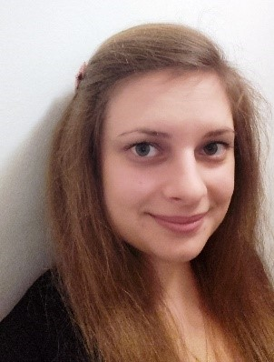
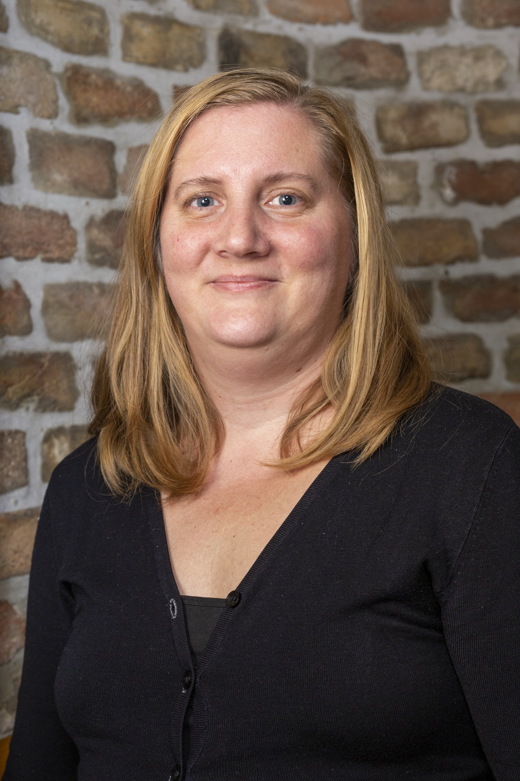
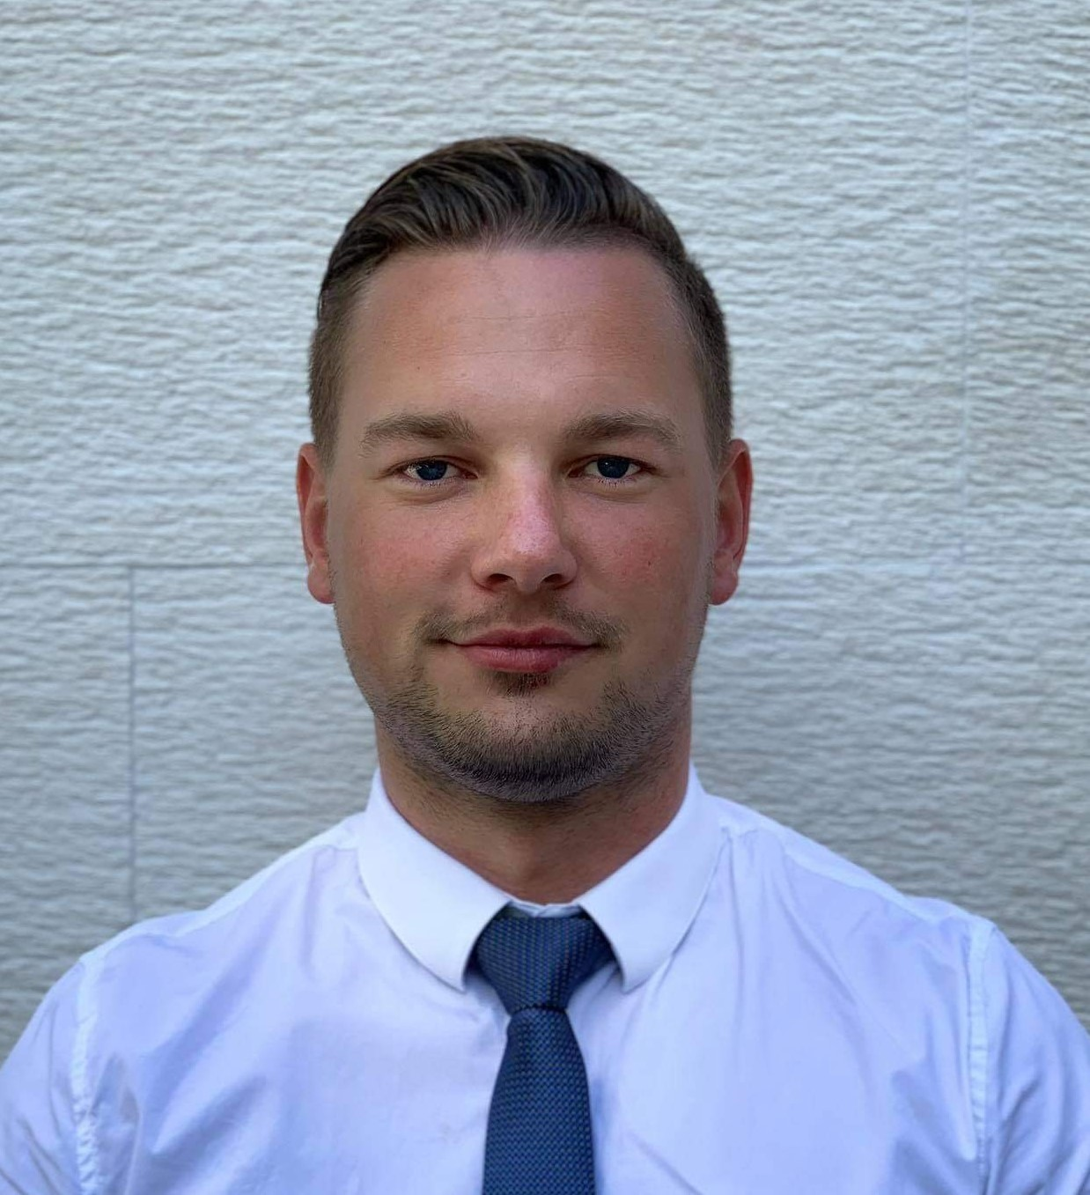
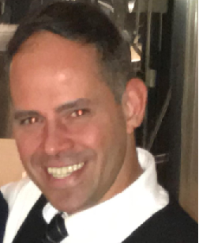
TEAM
FLÓRA KONKOLY-SÜMEGI
GYÖNGYI MAKÓ
SOMA BÁRTFAI
CSABA VADÁSZ
Fullstack developer
Authentication
Relationships
Dataloader
Backend developer
Authorization
Services
Tests
Backend developer
Authorization
Controllers
Tests
Backend developer
Git master
Interfaces
Tests

Slide 4
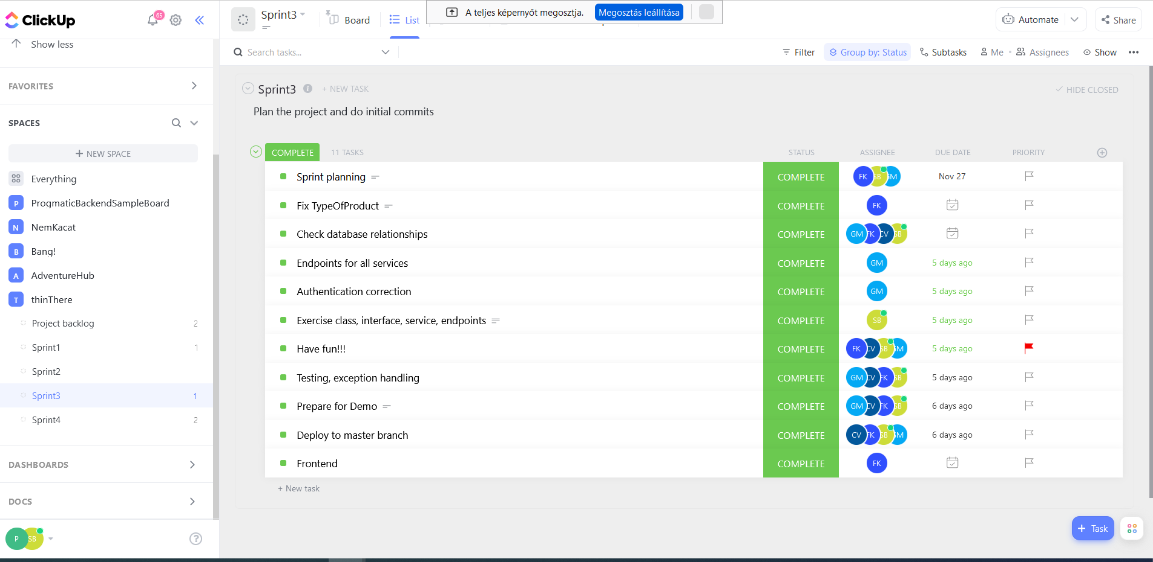
PLANNING
Main plans
Split of tasks
Pair programming
Clickup
Agile methodology
Scrum
Daily standups
Weekly demos

Slide 5
FEATURES
REGISTRATION
LOGIN
WEBSHOP
READ
UPDATE
DELETE
User/Admin
With JWT
Home, bodyshop, registration, login, admin
CREATE

Slide 6
AUTHORITIES
 | CREATE | READ | UPDATE | DELETE
USER | OWN | OWN | OWN | OWN
ADMIN | ALL | ALL | ALL | ALL

Slide 7
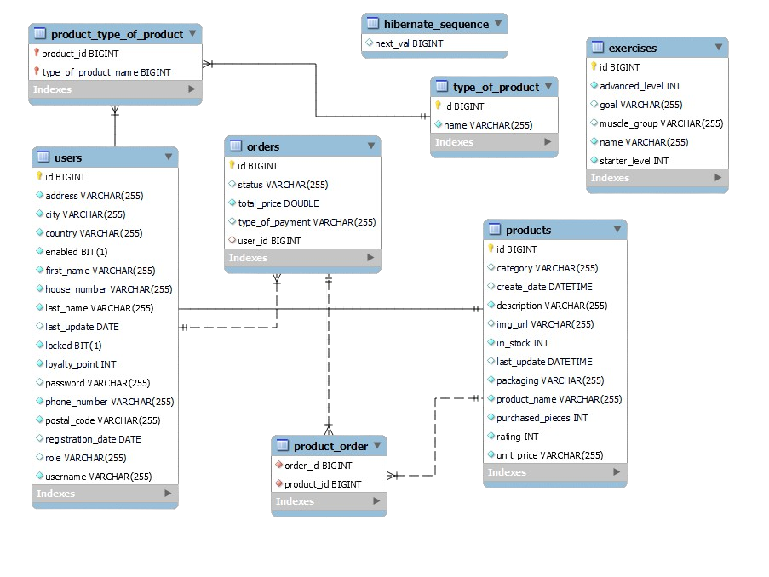
UML DIAGRAM

Slide 8











TECHNOLOGIES

Slide 9
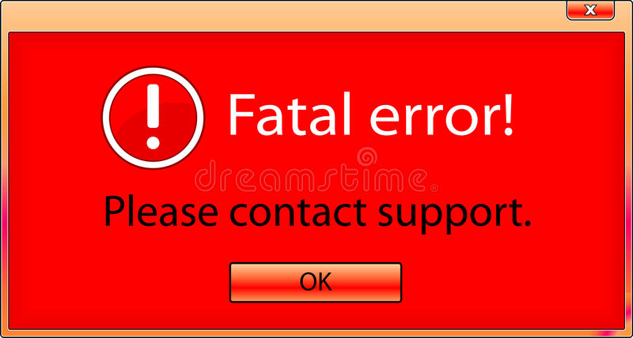
DIFFICULTIES AND CHALLENGES
GitHub – Branches – Merge
Backend -> Frontend
Angular/ts() => React/ts() => React/js
HELP!
Compromises

Slide 10
PLANS FOR THE FUTURE
PRODUCT RATINGS
COMMENTS
E-MAIL CONFIRMATION
Customer feedback
(1-5)
Opinion about products
Validation of registration

Slide 11


CONCLUSION

Slide 12
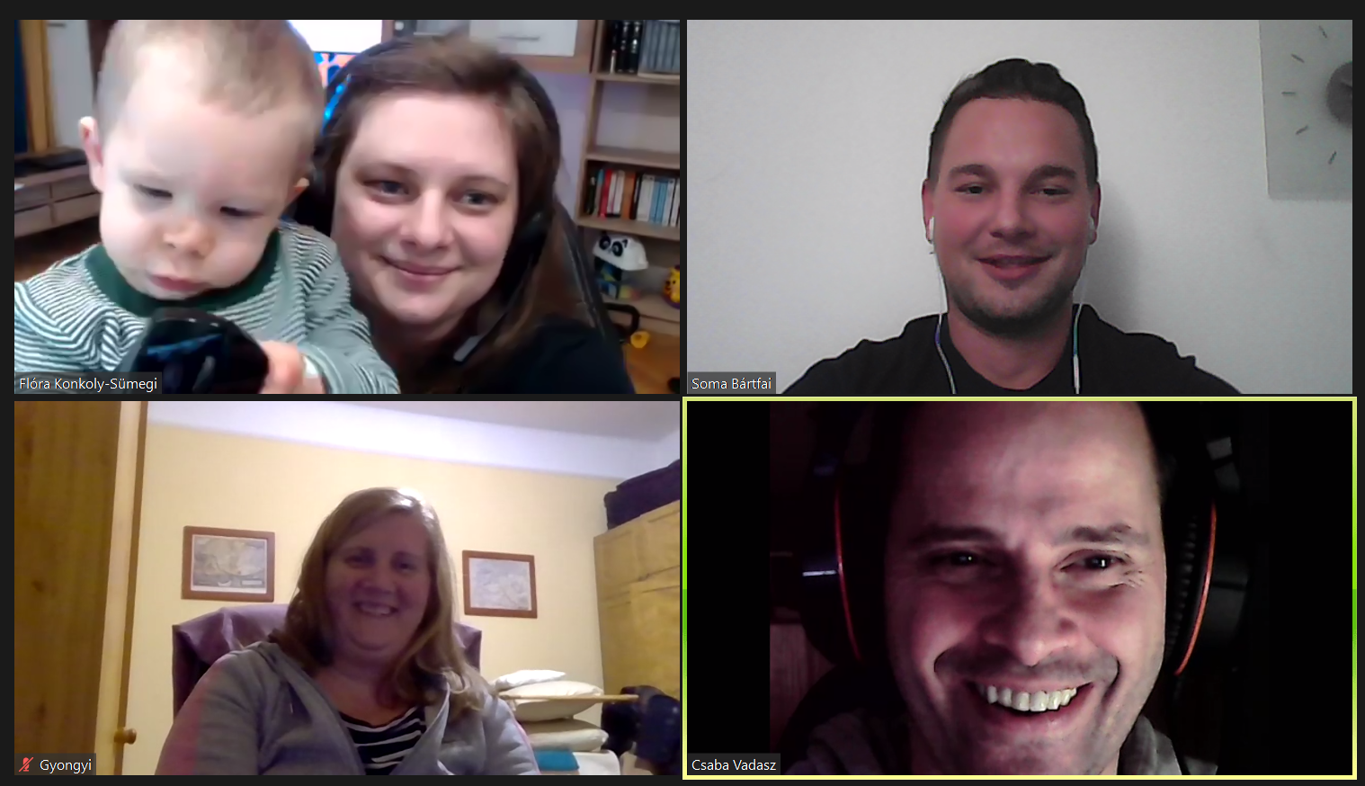
THANK YOU!

